Slide 1
Deep Learning
Lec 2

Slide 2
What is a neural network
Neuron activation function
Non linear with or without saturation
Architecture
Feed-forward
Convolution
Fully connected
Pooling
Recurrent
(Recursive)
Loss function
What is that you are minimizing (loss) in order to learn something (score)

Slide 3
Feedforward ANN

Slide 4
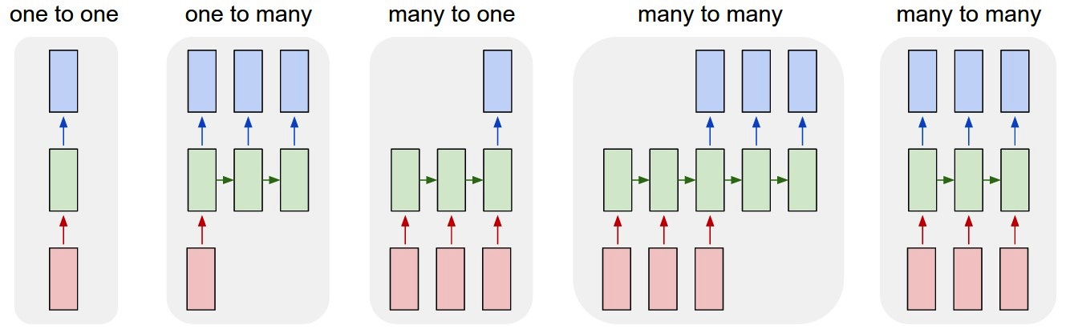
Recurrent ANN

Slide 5
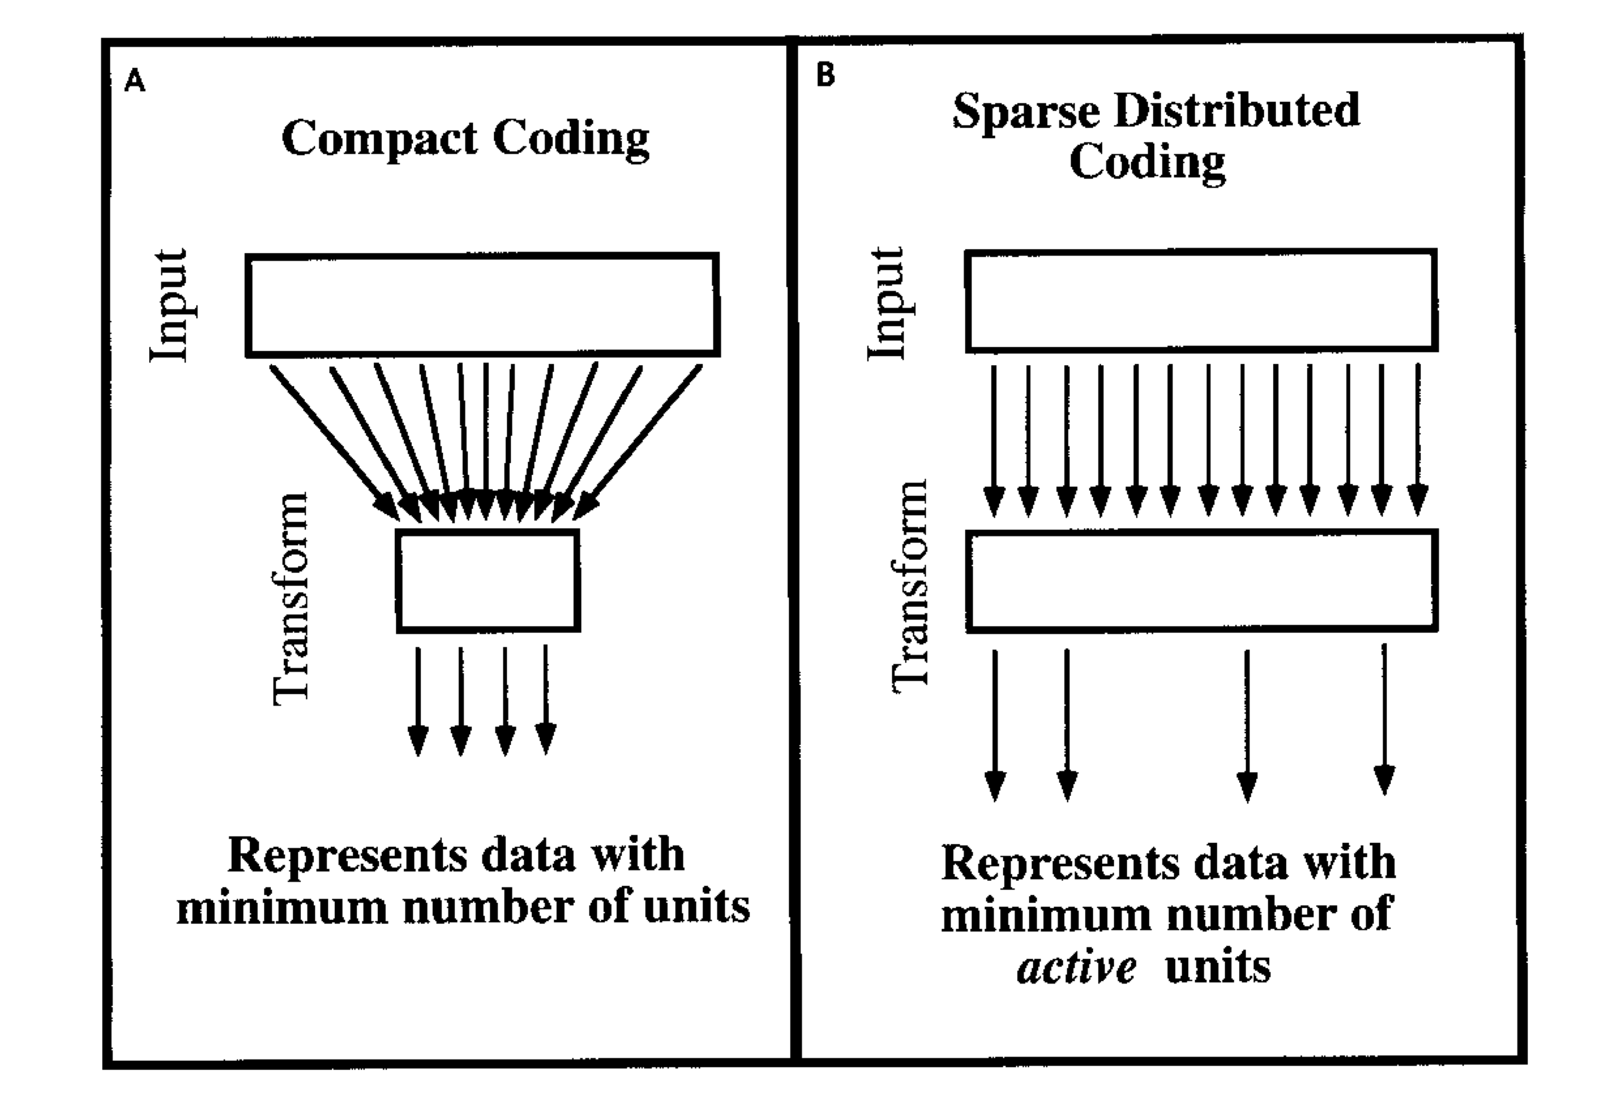
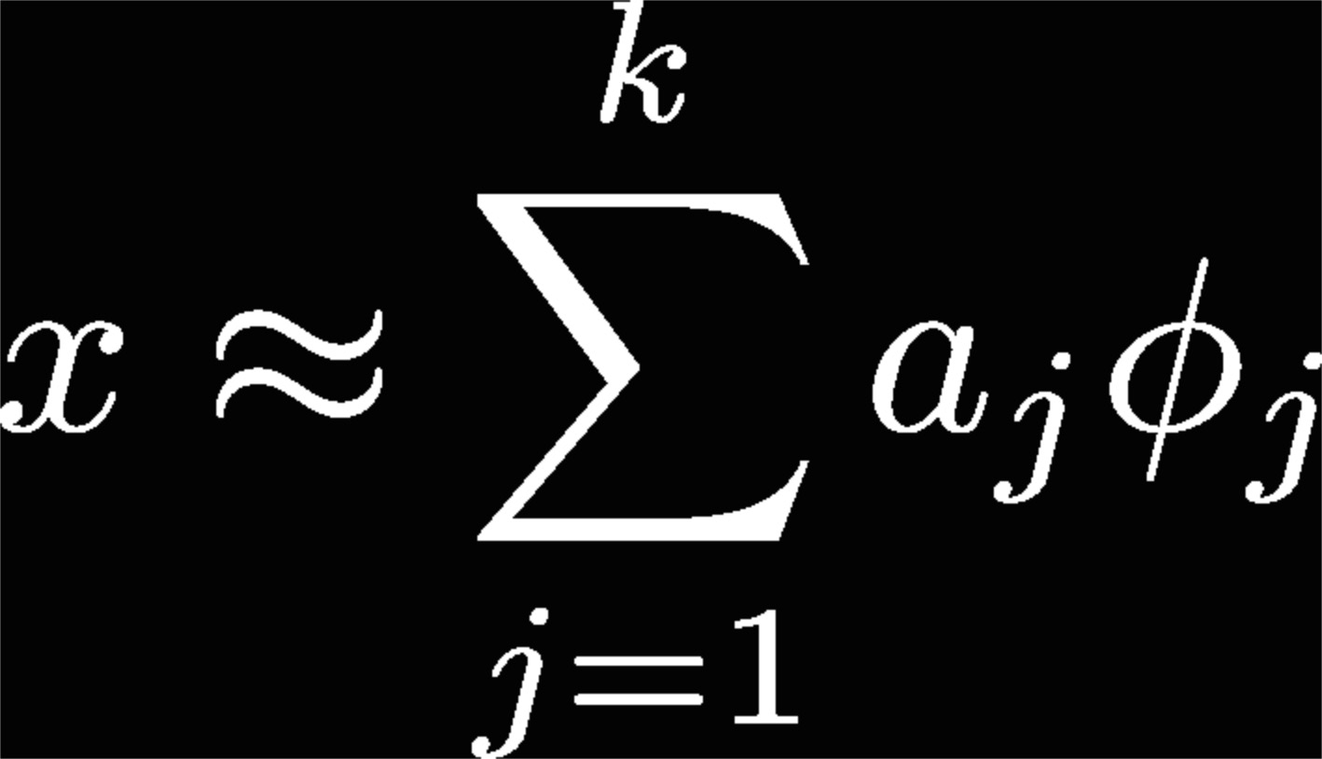
Basic Problem
A image, x, can be represented in terms of linear superposition of (not necessarily) basis function
Dictionary of bases φ₁, φ₂, …, φ_{k} (also R^{n x n})
Image code determined by choice of basis functions
Coefficients a are dynamic variables that change with each image
Goal is to find a set of basis functions that spans the image space and results in the coefficient values being statistically independent
Extract the intrinsic structure in sensory signals

Slide 6
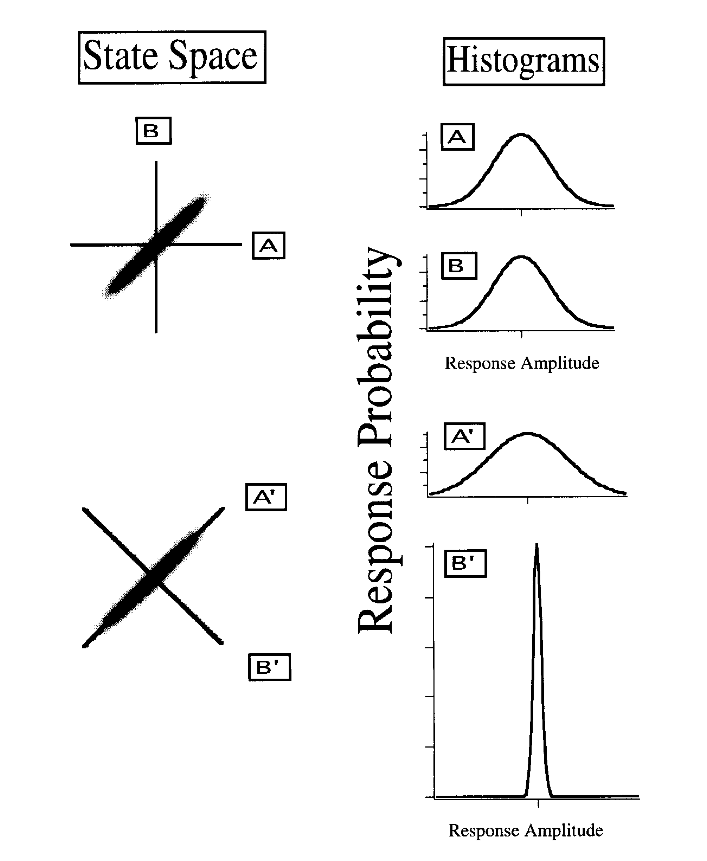
What is the goal of sensory coding
Uncorrelated
E[X,Y] = E[X]E[Y]
Independent
P(x,y) = P(x)P(y)
Independence implies Un-correlation
Vice versa?
PCA computes the eigenvalues of covariance matrix to diagnolize it
Eigenvectors represent a hierarchy of orthogonal coefficients where the highest value accounts for the greatest part of the covariance.

Slide 7
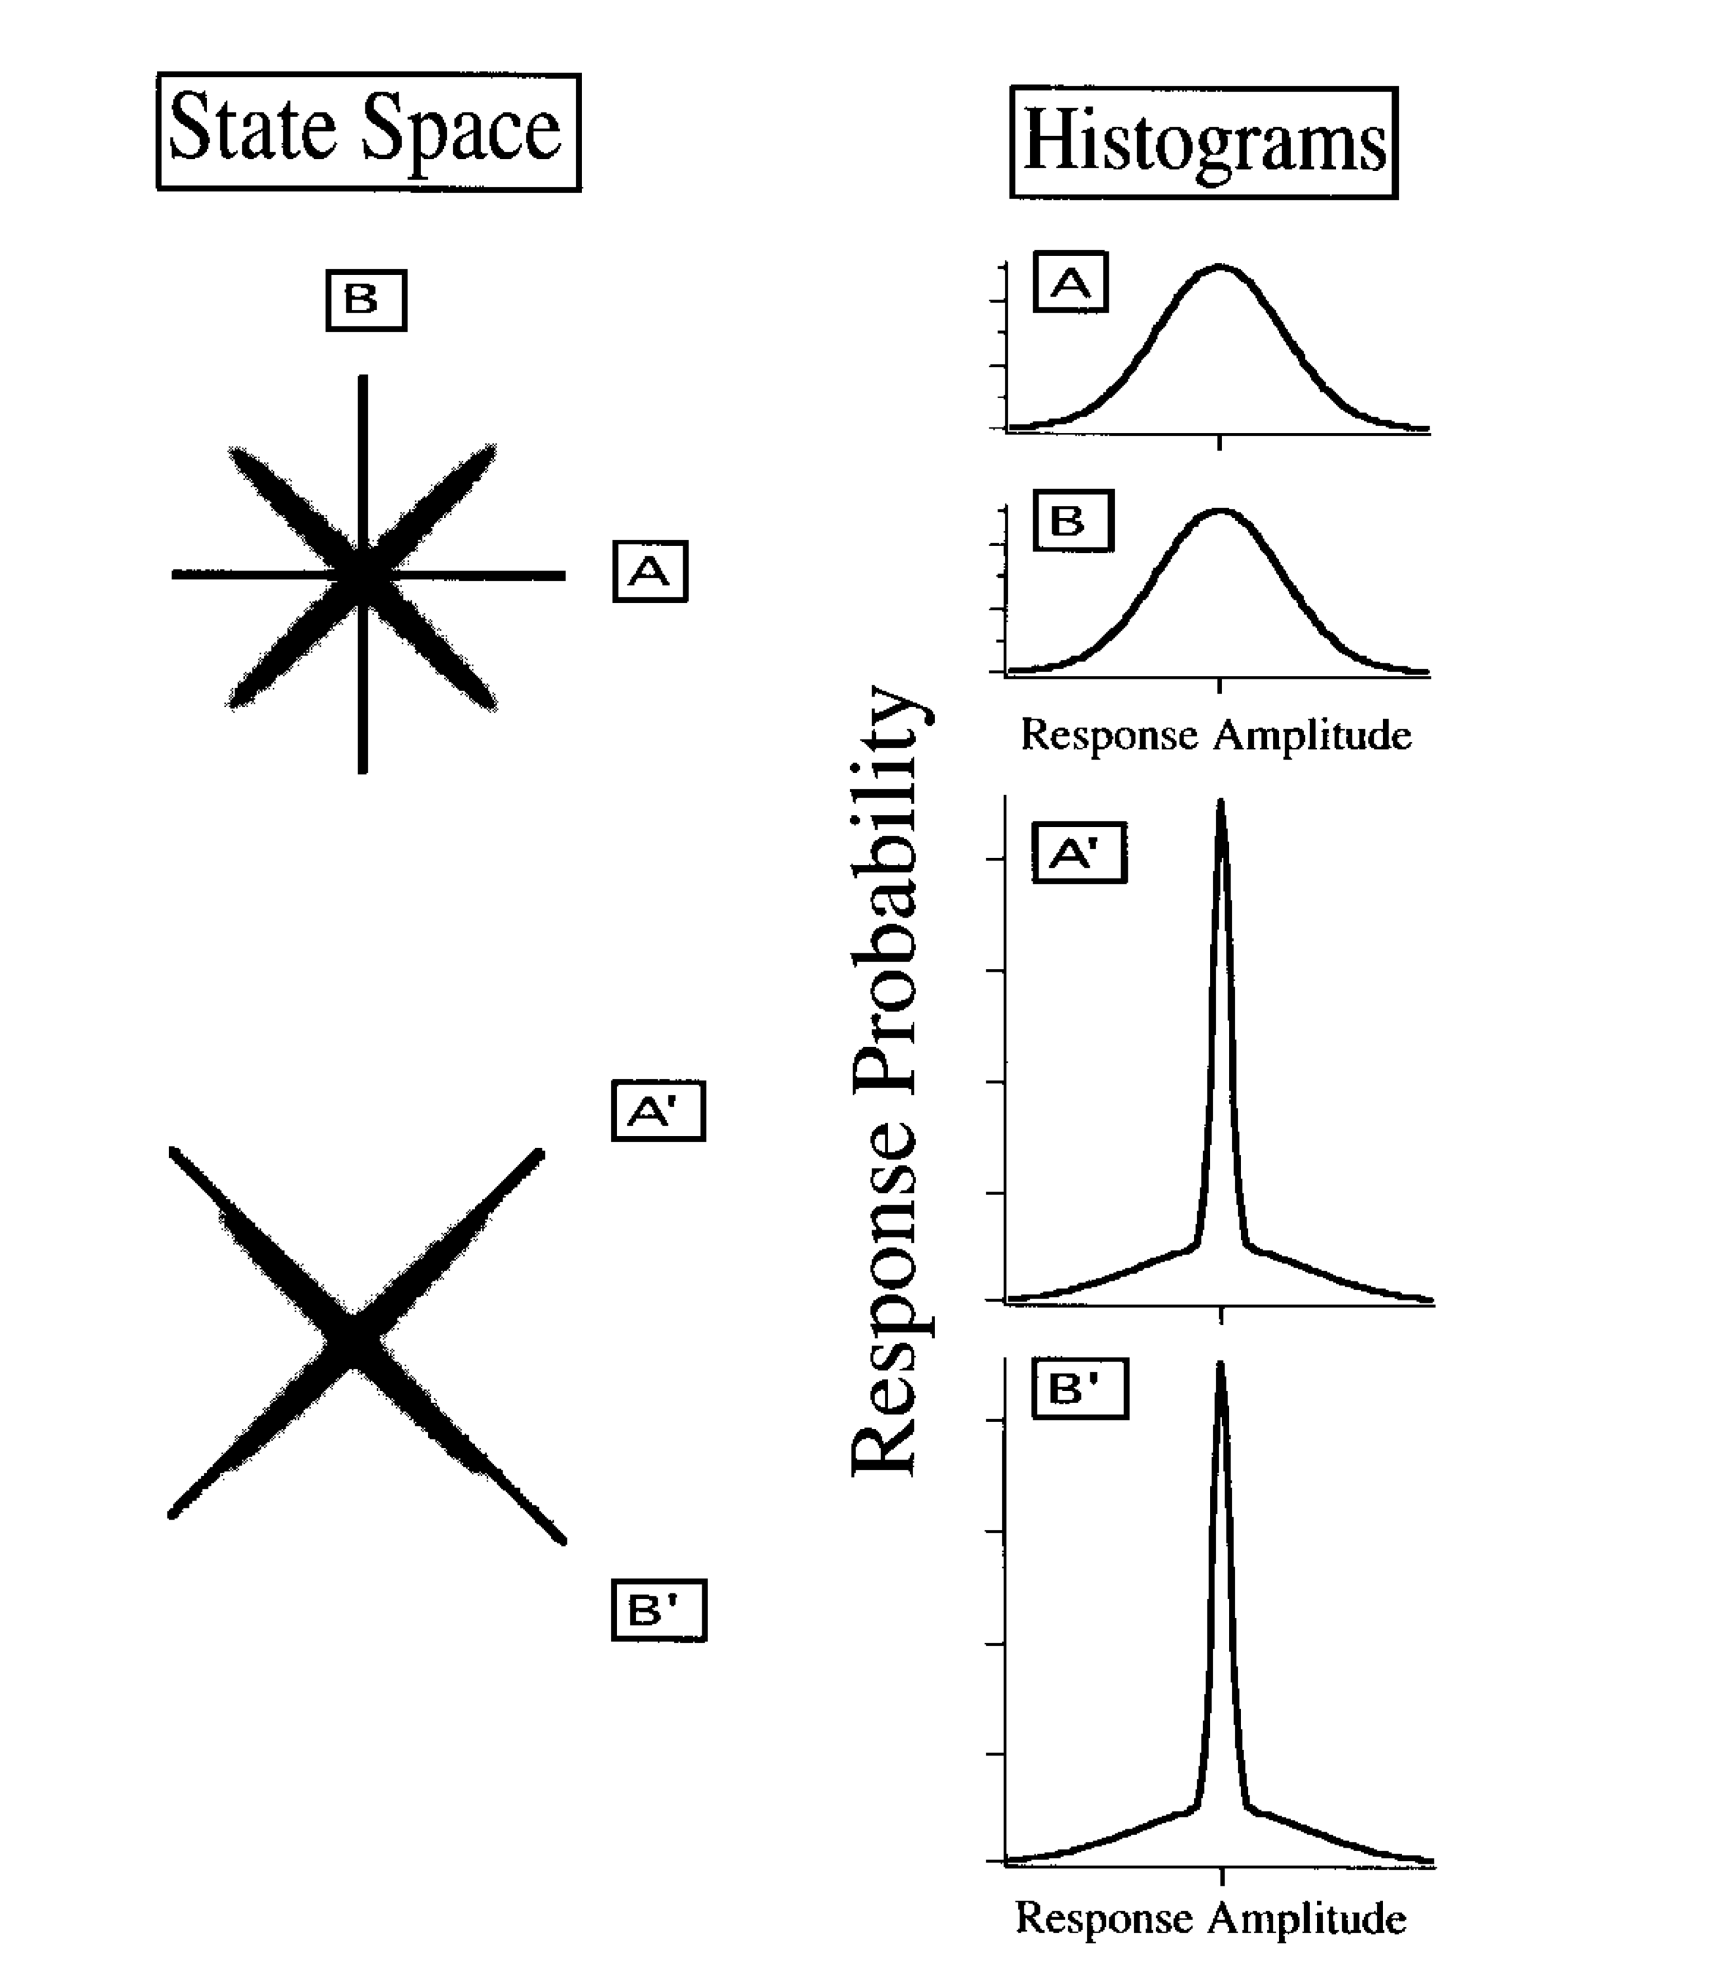
Sparse coding
Uncorrelated but redundant (dependent)
Variance of A’ B’ is same as of A,B
But high degree of kurtosis in A’ B’
Vector A’ is high or Vector B’ is high but not at the same time
Sparse code any given input can be described by only a subset of cells, where the subset changes with input

Slide 8
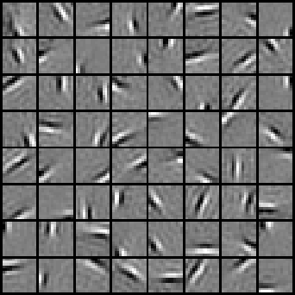
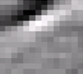


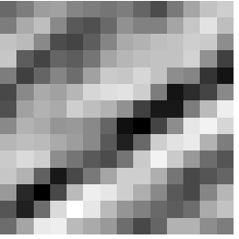


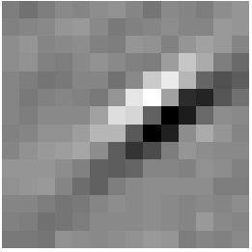
Sparse coding illustration
Natural Images
Learned bases (φ_{1 , …,} φ₆₄): “Edges”
Test example
≈ 0.8 * + 0.3 * + 0.5 *
x ≈ 0.8 * φ₃₆ + 0.3 * φ₄₂ + 0.5 * φ₆₃
[0, 0, …, 0, 0.8, 0, …, 0, 0.3, 0, …, 0, 0.5, …]
= [a₁, …, a₆₄] (feature representation)
Compact & easily
interpretable

Slide 9
Neural Networks and Principal Component Analysis: Learning from Examples Without Local Minima
Y
Landscape of E – the problem of finding A,B
to minimize E
B
A
X
Linear units are the simplest one can use in these circuits. They are often considered as uninteresting for: (a) only linear functions can be computed in linear networks (and most "interesting" functions are nonlinear); and (b) a network with several layers of linear units can always be collapsed into a linear network without any hidden layer by multiplying the weights in the proper fashion.
But they can provide important insights that non-linear units cannot

Slide 10
Contd
One of the central issues in learning from examples is the problem of generalization, that is, how does the network perform when exposed to a pattern never seen previously? In our setting, a precise quantitative answer can be given to this question. For instance, in the auto-associative case, the distortion on a new pattern is exactly given by its distance to the subspace generated by the first p eigenvectors of covariance matrix.
One of the nice features of the landscape of E is the existence, up to equivalence, of a unique local and global minimum which, in addition, can be described in terms of principal component analysis and least squares regression.
Therefore a critical AB of rank p is always the product of the ordinary least squares regression matrix followed by an orthogonal projection onto the subspace spanned by p eigenvectors of covariance matrix.

Slide 11
Matching Filter
Suppose r(t) = s(t) + n(t) , where n(t) is WGN with spectral height No/2, and s(t) is a signal with a finite duration T
Let r(t) be the input to a filter with impulse response h(t)
Let y(t) be the output

Slide 12
Matching Filter

Slide 13
Analysis of CNN-based Speech Recognition System using Raw Speech as Input
HMM based systems
Acoustic features extracted based on prior knowledge about speech perception and/or speech production
mel frequency cepstral coefficients (MFCC), perceptual linear prediction (PLP) cepstral coefficients, linear prediction cepstral coefficients
Acoustic modeling.
modeled by either Gaussian mixture models (GMM) or artificial neural networks (ANNs) to estimate state emission distribution.
Decision making, i.e. recognition, step
integrates the acoustic model, lexical knowledge and language model/syntactical constraints (again estimated independently on text data) to decode the test utterance.
Instead of conventional features, such as cepstral- based features, use “intermediate” representations as input for neural networks-based systems.
Notes:
The rip- ples present in the plots can be attributed to the fact that these filters are learned on sub-segmental speech signal, i.e. a dura- tion of 2-4 ms. It could be observed that the average frequency response is like a smooth spectral envelope.
Clearly, each filter learned by the network responds to different frequency bands of the input raw signal. These fil-
ters could be seen as matching filters.

Slide 14
Invariance of filters across database

Slide 15
Visualizing and Understanding Convolution Networks

Slide 16
De-convnet
Max pooling operation is non-invertible,
Obtain an approximate inverse by recording the locations of the maxima within each pooling region in a set of switch variables.
these switch settings are peculiar to a given input image, the reconstruction obtained from a single activation thus resembles a small piece of the original input image
Feature reconstructions at each layer which also should be positive, are passed through a relu non-linearity.
The convnet uses learned filters to convolve the feature maps from the previous layer.
To approximately invert this, the deconvnet uses transposed versions of the same filters but applied to the rectified maps, not the output of the layer beneath.

Slide 17
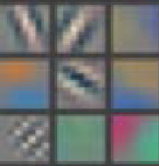
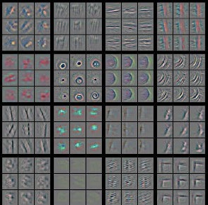


Feature visualization
For a given feature map,
Show the top 9 activations, each projected separately down to pixel space, revealing the different structures that excite that map and showing its invariance to input deformations. For layers 2-5 we show the top 9 activations in a random subset of feature map.
Alongside these visualizations we show the corresponding image patches.
Reconstructions are not samples from the model: they are reconstructed patterns from the validation set that cause high activations in a given feature map.
Layer 1
Layer 2
corners & edge/color conjunctions

Slide 18
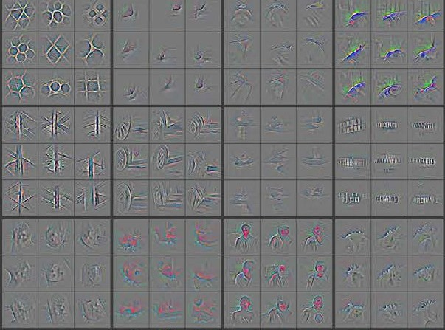
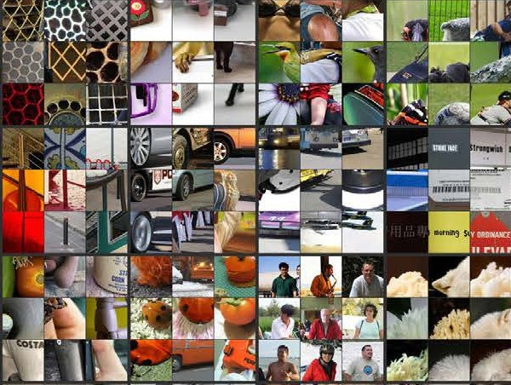
Feature visualization
Layer 3
similar textures

Slide 19



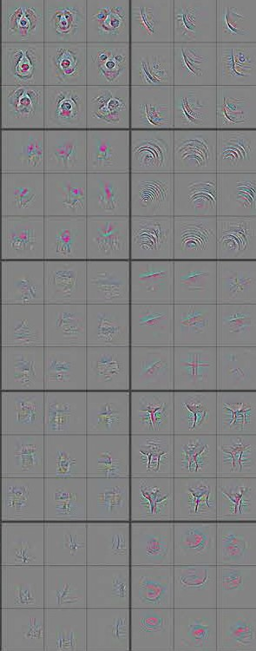
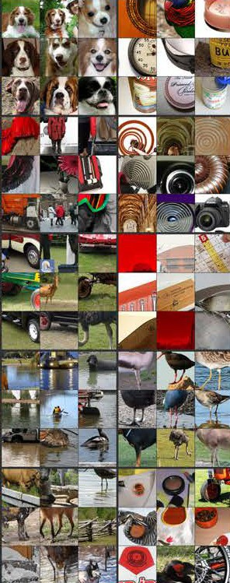
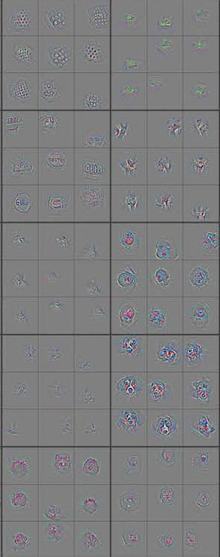
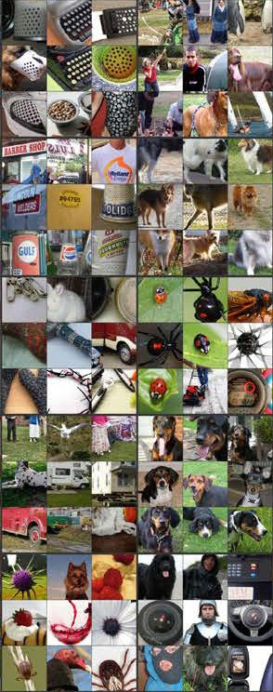
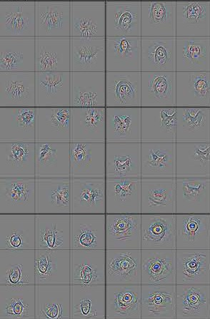
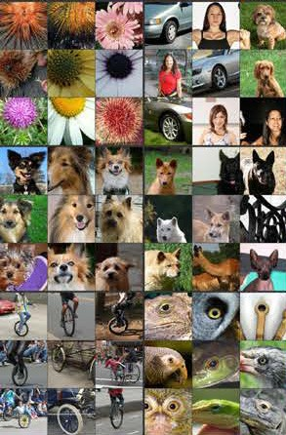




Feature visualization
Layer 4
Layer 5
Entire object with pose variation (dogs )
Object parts
(dog face & bird legs)

Slide 20
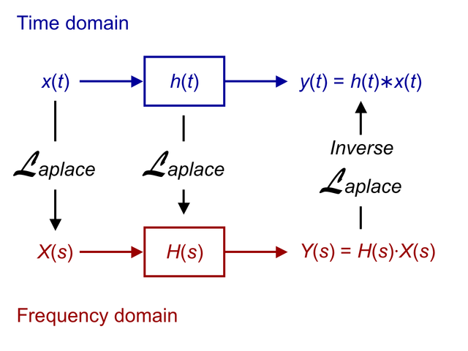
Convolution
the input can be represented by a continuum of time-shifted impulse functions, combined "linearly”.
the system's linearity property allows the system's response to be represented by the corresponding continuum of impulse responses, combined in the same way.
and the time-invariance property allows that combination to be represented by the convolution integral.
Stationarity
P(x_i| x_i+1,x_i+2…) = P(x_j |x_j+1, x_j+2….)
Does not imply the properties do not change,
implies that the probability of finding
a feature is the same at every location
Composition
Each filter composes a local patch of
lower-level features into higher-level representation.
Instead of image pixels, the input to most NLP tasks are sentences or documents represented as a matrix. Each row of the matrix corresponds to one token, typically a word, but it could be a character. That is, each row is vector that represents a word.

Slide 21
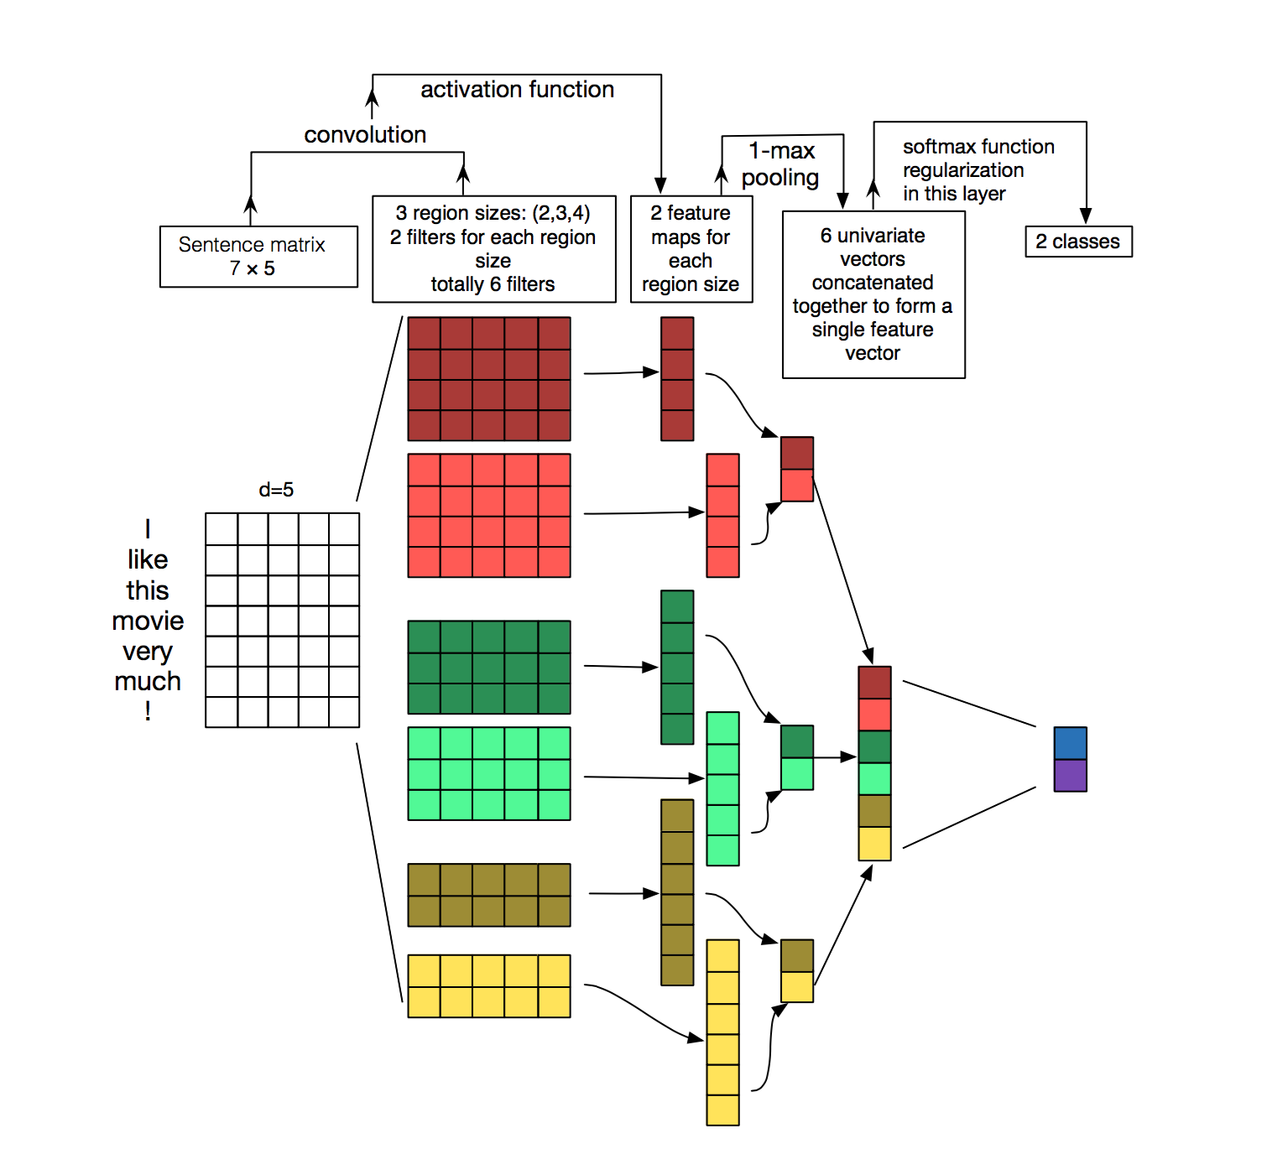
Understanding Convolution networks for NLP
In vision, our filters slide over local patches of an image, but in NLP we typically use filters that slide over full rows of the matrix (words). Thus, the “width” of our filters is usually the same as the width of the input matrix. The height, or region size, may vary, but sliding windows over 2-5 words at a time is typical.

Slide 22
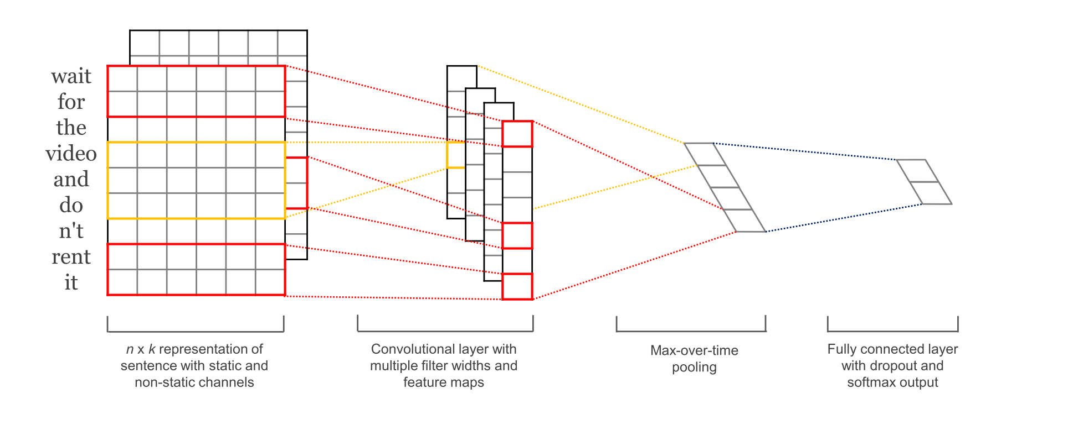
Convolutional Neural Networks for Sentence Classification
http://www.wildml.com/2015/11/understanding-convolutional-neural-networks-for-nlp/
The CNN architecture achieves very good performance across datasets, and new state-of-the-art on a few.
The network used in this paper is quite simple, and that’s what makes it powerful.
The paper also experiments with two different channels in the form of static and dynamic word embeddings, where one channel is adjusted during training and the other isn’t.

Slide 23
Evaluation of Pooling Operations in Convolutional Architectures for Object Recognition
Pooling provides a fixed size output matrix, which typically is required for classification. For example, if you have 1,000 filters and you apply max pooling to each, you will get a 1000-dimensional output, regardless of the size of your filters, or the size of your input.
Shown that a max pooling operation is vastly superior for capturing invariances in image-like data, compared to a subsampling operation.
Pooling also reduces the output dimensionality but (hopefully) keeps the most salient information.
if the sentence contains a negation like “not amazing” for example.
this phrase occurs somewhere in the sentence, the result of applying the filter to that region will yield a large value, but a small value in other regions.
By performing the max operation you are keeping information about whether or not the feature appeared in the sentence, but you are losing information about where exactly it appeared.
In imagine recognition, pooling also provides basic invariance to translating (shifting) and rotation. When you are pooling over a region, the output will stay approximately the same even if you shift/rotate the image by a few pixels, because the max operations will pick out the same value regardless.

Slide 24
Spatial Transformer Network
A desirable property of a system which is able to reason about images is to disentangle object pose and part deformation from texture and shape. The introduction of local max-pooling layers in CNNs has helped to satisfy this property by allowing a network to be somewhat spatially invariant to the position of features.
However, due to the typically small spatial support for max-pooling (e.g. 2 ⇥ 2 pixels) this spatial invariance is only realised over a deep hierarchy of max-pooling and convolutions, and the intermediate feature maps (convolutional layer activations) in a CNN are not actually invariant to large transformations of the input data
Unlike pooling layers, where the receptive fields are fixed and local, the spatial transformer module is a dynamic mechanism that can actively spatially transform an image (or a feature map) by producing an appropriate transformation for each input sample.
The transformation is then performed on the entire feature map (non-locally) and can include scaling, cropping, rotations, as well as non-rigid deformations. This allows networks which include spatial transformers to not only select regions of an image that are most relevant (attention), but also to transform those regions to a canonical, expected pose to simplify recognition in the following layers.

Slide 26
Converting FC layers to CONV layers
It is worth noting that the only difference between FC and CONV layers is that the neurons in the CONV layer are connected only to a local region in the input, and that many of the neurons in a CONV volume share parameters. However, the neurons in both layers still compute dot products, so their functional form is identical.
For any CONV layer there is an FC layer that implements the same forward function. The weight matrix would be a large matrix that is mostly zero except for at certain blocks (due to local connectivity) where the weights in many of the blocks are equal (due to parameter sharing).
Conversely, any FC layer can be converted to a CONV layer. For example, an FC layer with K=4086, looking at input size of 7x7x512 can be equivalently expressed as a CONV layer with F= 7, P=0, S = 1, K = 4096. In other words, we are setting the filter size to be exactly the size of the input volume.
Netsurgery.pynb on caffenet

